Slide 1


Some Advances and Challenges on POPulation-Based Randomized Optimization Algorithms (POP) for High-Dimensional Black-Box Optimization/Search (BBO)
Qiqi Duan, SUSTech & HIT, China
For LEAD Workshop (Virtual) at SCUT, China
In Sept. 13, 2025
LEAD Website: https://sites.google.com/view/leadworkshop2025/
My Personal Website: https://evolutionary-intelligence.github.io/
http://creativecommons.org/licenses/by/4.0/

Slide 2
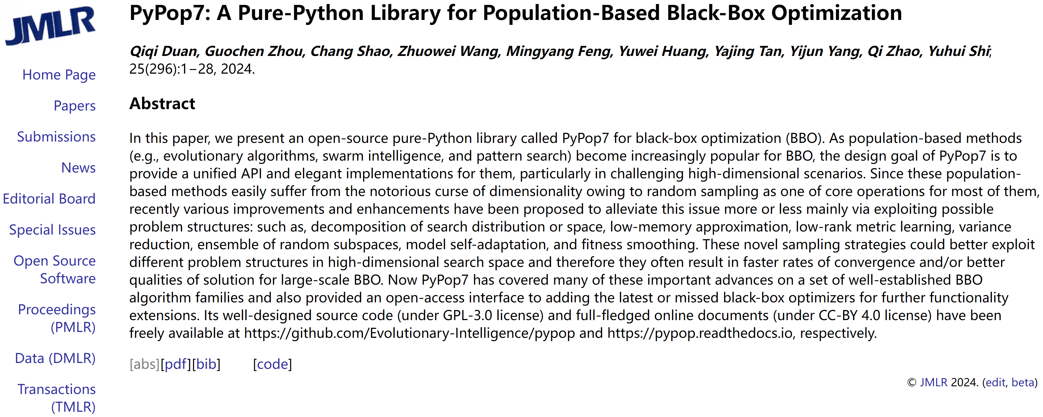


Slide 3
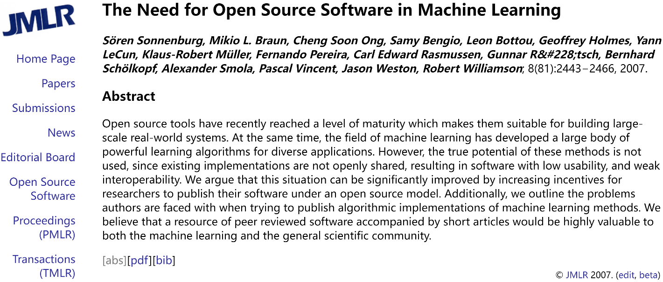
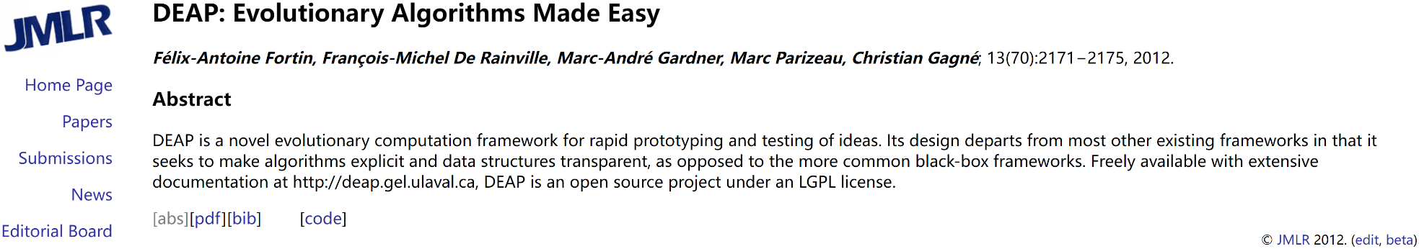
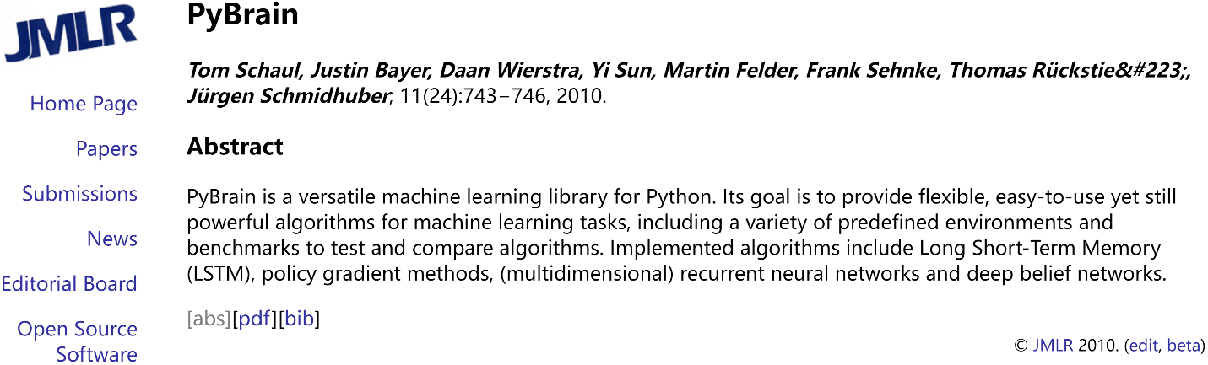
Just To Name a Few

Slide 4
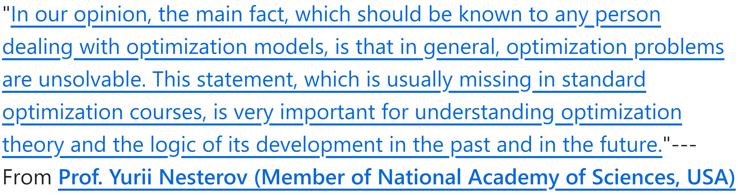
What is Black-Box Optimization (BBO)?
To properly answer this seemingly simple question
An interdisciplinary perspective may be needed to show its necessity
Applications
A historical perspective may help to deepen our understanding
Algorithms

Slide 5
Name and Field Diversity in BBO (NOTE that subtle differences between them are not considered here)
Academic Society (NOT complete):
AC: IEEE Control Systems Society (TAC) + International Federation of Automatic Control (Automatica);
AM: Society for Industrial and Applied Mathematics (SIOPT / SICON);
EC: ACM Special Interest Group on Genetic and Evolutionary Computation (TELO / GECCO / FOGA) + IEEE Computational Intelligence Society (TEVC / CEC / SSCI) + (ECJ);
ML: International Machine Learning Society (ICML) + (NeurIPS / ICLR);
MH/SC: (ASOC / PPSN / ICM);
MO: Mathematical Programming Society (Util 2010) / Mathematical Optimization Society (MP / MPC);
OR: Institute for Operations Research and the Management Sciences (OR / IJOC);
RL: (RLJ / RLC);
S: American Statistical Association + Royal Statistical Society;
SI: (SIJ / IJSIR / CIJ / ANTS / ICSI);
……
Derivative-Free Optimization
Direct Search
Experiment Design
Generation-And-Test
Global Optimization
Gradient-Free Optimization
Monte Carlo-Based Optimization
Nondifferentiable Optimization
Optimization Without Derivatives
Random Search/Optimization
Simulation-Based Optimization
Zeroth-Order Optimization
Welcome to supplement > Hybridization

Slide 6
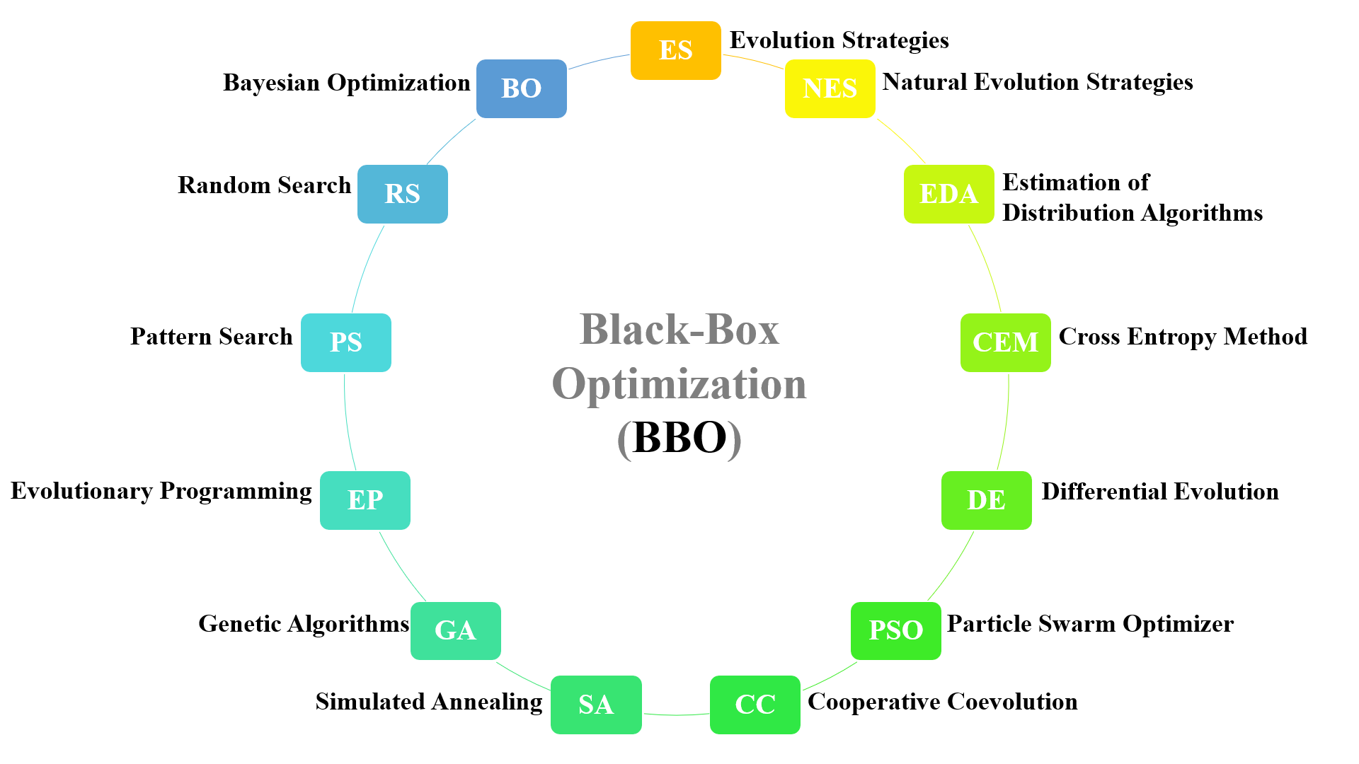
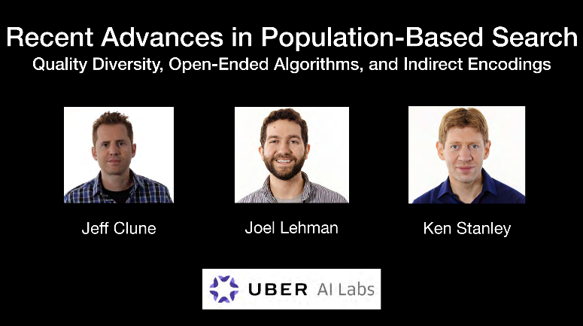
Algorithm Diversity in BBO (NOTE that not all of algorithm choices are considered here: Obtaining an enumerative list is really hard)
Dimensions of classification:
Individual vs Population
Deterministic vs Randomized
Model-Based vs Model-Free
……
(In Arbitrary Order)
https://icml.cc/media/icml-2019/Slides/4336.pdf
Consensus-Based Optimization (CBO) [Fornasier et al., 2024, SIOPT]
Competitive Coevolution

Slide 7
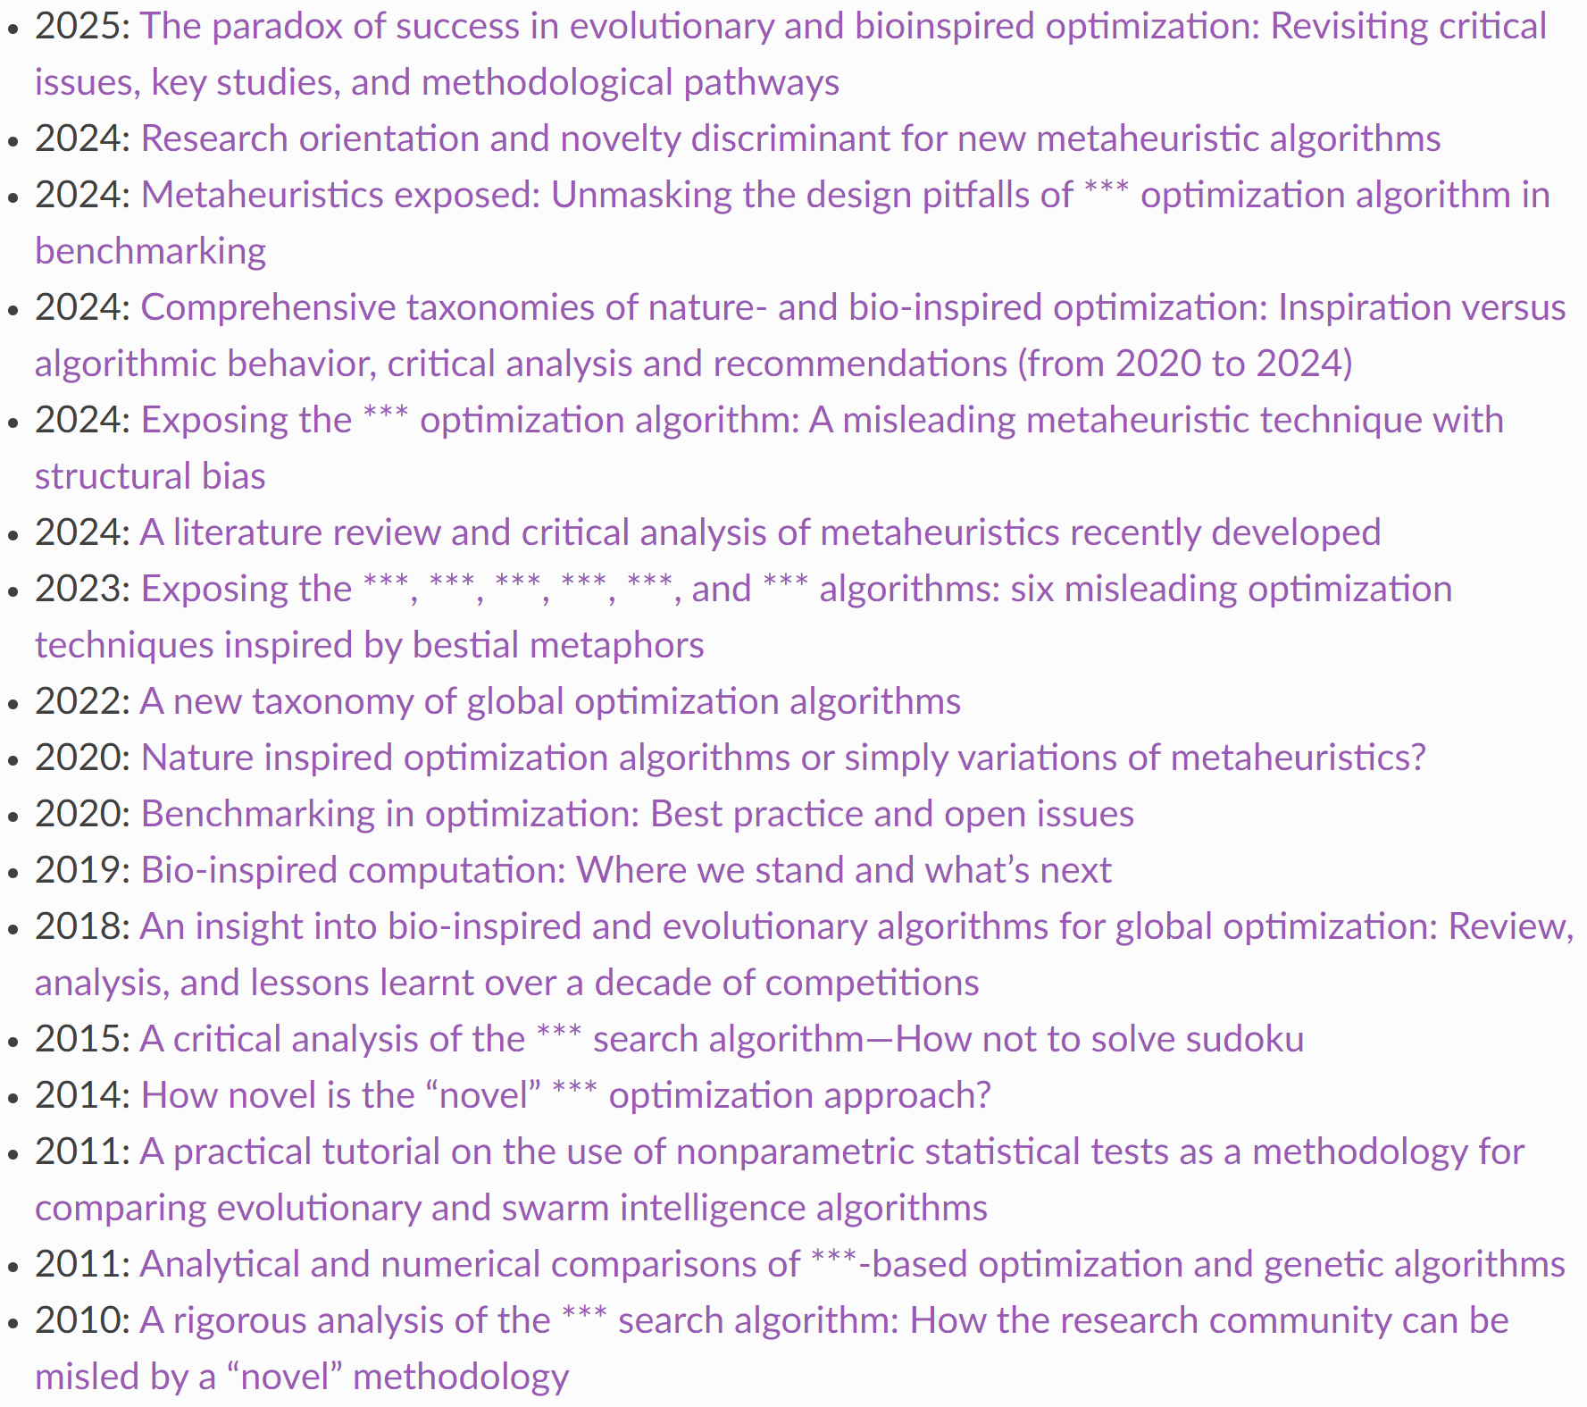
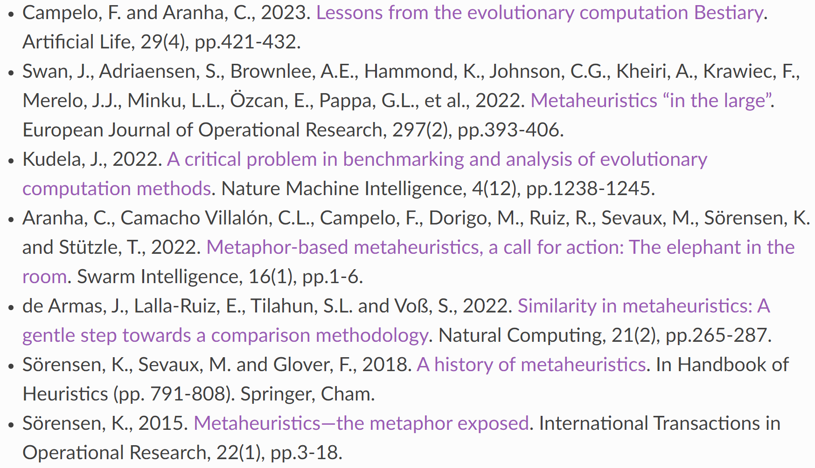
Algorithm Diversity
Dr. Glover is an elected member of the U.S. National Academy of Engineering and is the recipient of the John von Neumann Theory Prize, the highest honor of the Institute for Operations Research and the Management Sciences.
From https://en.wikipedia.org/wiki/Fred_W._Glover

Slide 8
When to Use/Design BBO Algorithms?
“BBO methods are sometimes employed for convenience rather than by necessity.” [Larson et al., 2019, Acta Numerica]
“Many of its customers would have gone elsewhere if they had been asked to specify the first derivatives.” [Powell, 1998, Acta Numerica]
(Just to name a few)
Berahas, Byrd and Nocedal, 2019. Derivative-free optimization of noisy functions via quasi-Newton methods. SIAM Journal on Optimization.
Larson, Menickelly and Wild, 2019. Derivative-free optimization methods. Acta Numerica.
Conn, Scheinberg and Vicente, 2009. Introduction to derivative-free optimization. Society for Industrial and Applied Mathematics. (Cited by > 2K)
Powell, 1998. Direct search algorithms for optimization calculations. Acta Numerica.
……

Slide 9
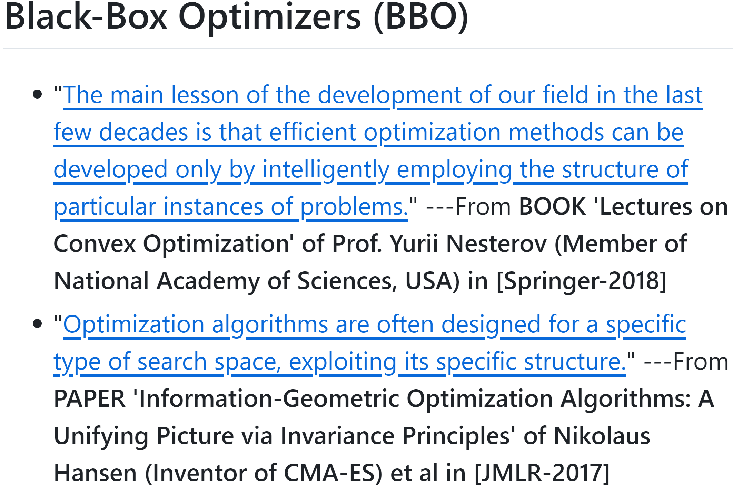

Slide 10
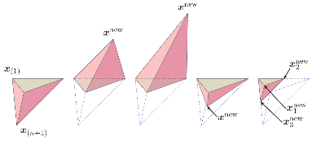
Pattern/Direct Search (PS/DS)
© Larson et al., 2019, AN
Fermi and Metropolis, 1952. Numerical solution of a minimum problem. TR, Los Alamos Scientific Lab.
https://www.nobelprize.org/prizes/physics/1938/fermi/biographical/ (Nobel Prize in Physics 1938)
https://history.computer.org/pioneers/metropolis.html (Computer Pioneer Award)
Hooke and Jeeves, 1961. “Direct search” solution of numerical and statistical problems. JACM. (Cited by > 6K)
Powell, 1964. An efficient method for finding the minimum of a function of several variables without calculating derivatives. CJ.
https://royalsocietypublishing.org/doi/10.1098/rsbm.2017.0023 (Member of RS and NAS)
Nelder and Mead, 1965. A simplex method for function minimization. CJ. (Cited by > 41K)
Wright, 1996. Direct search methods: Once scorned, now respectable. Pitman Research Notes in Mathematics Series.
https://www.simonsfoundation.org/people/margaret-h-wright/ (Member of NAS and NAE)
Lagarias, Reeds, Wright and Wright, 1998. Convergence properties of the Nelder--Mead simplex method in low dimensions. SIOPT. (Cited by > 10K)
Powell, 1998. Direct search algorithms for optimization calculations. AN.
https://github.com/Evolutionary-Intelligence/pypop?tab=readme-ov-file#patterndirect-search-psds

Slide 11
Randomized Search/Optimization (RS/RO): Part 1 – AC / OR / MP
Ashby, 1952. Design for a brain: The origin of adaptive behaviour. Springer. (Cited by > 6K)
https://ashby.info (A Pioneer in Cybernetics and Systems Theory)
Brooks, 1958. A discussion of random methods for seeking maxima. OR.
Rastrigin, 1963. The convergence of the random search method in the extremal control of a many parameter system. A&RC.
Matyas, 1965. Random optimization. A&RC.
Schumer and Steiglitz, 1968. Adaptive step size random search. TAC.
https://www.cs.princeton.edu/~ken/ (ACM/IEEE Fellow)
Solis and Wets, 1981. Minimization by random search techniques. MOR. (Cited by > 2K)
Zhigljavsky and Pinter, 1991. Theory of global random search. Springer.
Zabinsky and Smith, 1992. Pure adaptive search in global optimization. MP.
https://www.informs.org/Recognizing-Excellence/Award-Recipients/Zelda-Zabinsky (INFORMS Fellow)
https://www.informs.org/Explore/History-of-O.R.-Excellence/Biographical-Profiles/Smith-Robert-L (INFORMS Fellow)
Stich, 2014. On low complexity acceleration techniques for randomized optimization. In PPSN. Springer.
https://www.sstich.ch/ (AE in JMLR)
Wang, Hong, Jiang and Shen, 2025. Gaussian process-based random search for continuous optimization via simulation. OR.
https://github.com/Evolutionary-Intelligence/pypop?tab=readme-ov-file#random-searchoptimization-rsro

Slide 12
Randomized Search/Optimization (RS/RO): Part 2 – AI / ML / CM
Schmidhuber, Hochreiter, and Bengio, 2001. Evaluating benchmark problems by random guessing. A Field Guide to Dynamical Recurrent Networks.
https://people.idsia.ch/~juergen/ (Neural Networks Pioneer Award 2016)
https://www.jku.at/en/institute-for-machine-learning (Neural Networks Pioneer Award 2021)
https://yoshuabengio.org/ (A.M. Turing Award Laureate 2018 / Neural Networks Pioneer Award 2019)
Rosenstein, M.T. and Barto, A.G., 2001. Robot weightlifting by direct policy search. IJCAI.
https://amturing.acm.org/award_winners/barto_9471663.cfm (A.M. Turing Award Laureate 2024)
Bergstra and Bengio, 2012. Random search for hyper-parameter optimization. JMLR. (Cited by >15K)
https://yoshuabengio.org/ (A.M. Turing Award Laureate 2018 / Neural Networks Pioneer Award 2019)
“Low Effective Dimensionality (LED)”
“The most promising and interesting direction … is certainly in adaptive algorithms”: (Rechenberg, 1973; Hansen et al., 2003)
Nesterov and Spokoiny, 2017. Random gradient-free minimization of convex functions. FoCM. (Cited by >1K)
https://www.nasonline.org/directory-entry/yurii-e-nesterov-5n5mo7/ (Member of NAS)
“The Seminal Article” + “A Particularly Striking Result” (Review Paper “Derivative-Free Optimization Methods” in 2019)
Mania, Guy and Recht, 2018. Simple random search of static linear policies is competitive for reinforcement learning. NeurIPS.
Sener and Koltun, 2020. Learning to guide random search. In ICLR.
Gao and Sener, 2022. Generalizing Gaussian smoothing for random search. In ICML.
https://github.com/Evolutionary-Intelligence/pypop?tab=readme-ov-file#random-searchoptimization-rsro

Slide 13
POPulation-Based Randomized Optimization Algorithms (e.g., EA/SI)
Miikkulainen, R., 2025. Neuroevolution insights into biological neural computation. Science.
https://www.cs.utexas.edu/~risto/ (AAAI/IEEE/INNS Fellow + IEEE CIS Evolutionary Computation Pioneer Award 2020)
Miikkulainen and Forrest, 2021. A biological perspective on evolutionary computation. Nature Machine Intelligence.
https://search.asu.edu/profile/3182641 (ACM-AAAI Allen Newell Award + IEEE Fellow + IEEE CIS Evolutionary Computation Pioneer Award 2023)
Eiben and Smith, 2015. From evolutionary computation to the evolution of things. Nature.
http://www.evolutionarycomputation.org/
Bonabeau, Dorigo and Theraulaz, 2000. Inspiration for optimization from social insect behaviour. Nature.
https://iridia.ulb.ac.be/~mdorigo/HomePageDorigo/index.php (AAAI/IEEE Fellow + IEEE CIS Evolutionary Computation Pioneer Award 2016)
Forrest, 1993. Genetic algorithms: Principles of natural selection applied to computation. Science.
Bounds, 1987. New optimization methods from physics and biology. Nature.

Slide 14
Evolution Strategies (ES) / Natural Evolution Strategies (NES) / Persistent Evolution Strategies (PES)
Akimoto, Auger, Glasmachers and Morinaga, 2022. Global linear convergence of evolution strategies on more than smooth strongly convex functions. SIOPT.
Vicol, Metz and Sohl-Dickstein, 2021. Unbiased gradient estimation in unrolled computation graphs with persistent evolution strategies. In ICML.
Ye and Zhang, 2019. Mirror natural evolution strategies. arXiv.
Salimans, Ho, Chen, Sidor and Sutskever, 2017. Evolution strategies as a scalable alternative to reinforcement learning. arXiv.
Ollivier, Arnold, Auger and Hansen, 2017. Information-geometric optimization algorithms: A unifying picture via invariance principles. JMLR.
Auger and Hansen, 2016. Linear convergence of comparison-based step-size adaptive randomized search via stability of Markov chains. SIOPT.
Diouane, Gratton and Vicente, 2015. Globally convergent evolution strategies. MP.
Wierstra, Schaul, Glasmachers, Sun, Peters and Schmidhuber, 2014. Natural evolution strategies. JMLR. (CEC-2008; ICML-2009)
Bäck, Foussette and Krause, 2013. Contemporary evolution strategies. Springer.
Thomas Bäck: IEEE Fellow + IEEE CIS Evolutionary Computation Pioneer Award 2015
Hansen, Müller and Koumoutsakos, 2003. Reducing the time complexity of the derandomized evolution strategy with covariance matrix adaptation (CMA-ES). ECJ.
https://cse-lab.seas.harvard.edu/people/petros-koumoutsakos (Member of US National Academy of Engineering)
Beyer and Schwefel, 2002. Evolution strategies–A comprehensive introduction. NC.
Hans-Paul Schwefel: IEEE Fellow + IEEE CIS Evolutionary Computation Pioneer Award 2002 (with Ingo Rechenberg)

Slide 15
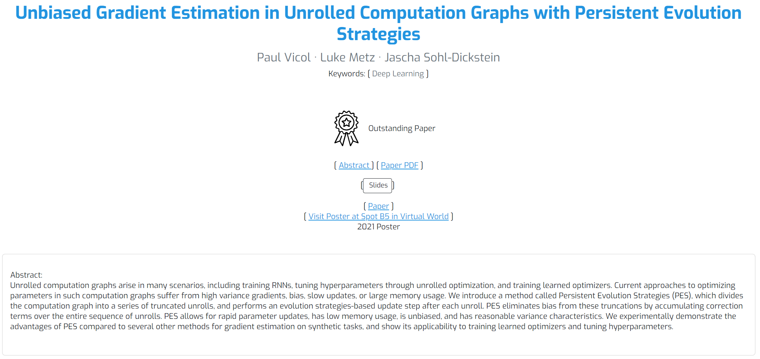
https://icml.cc/virtual/2021/poster/10175

Slide 16
Particle Swarm Optimizer (PSO) / Consensus-Based Optimization (CBO)
Bungert, Roith and Wacker, 2025. Polarized consensus-based dynamics for optimization and sampling. MP.
Lyu and Chen, 2025. Consensus based stochastic optimal control. In ICML.
Carrillo, Trillos, Li and Zhu, 2024. FedCBO: Reaching group consensus in clustered federated learning through consensus-based optimization. JMLR.
Huang, Qiu and Riedl, 2024. Consensus-based optimization for saddle point problems. SICON.
Bolte, Miclo and Villeneuve, 2023. Swarm gradient dynamics for global optimization: the mean-field limit case. MP.
Borghi, Herty and Pareschi, 2023. Constrained consensus-based optimization. SIOPT.
Fornasier, Huang, Pareschi and Sünnen, 2022. Anisotropic diffusion in consensus-based optimization on the sphere. SIOPT.
Fornasier, Huang, Pareschi and Sünnen, 2021. Consensus-based optimization on the sphere: Convergence to global minimizers and machine learning. JMLR.
Yuan and Yin, 2015. Analyzing convergence and rates of convergence of particle swarm optimization algorithms using stochastic approximation methods. TAC.
Eberhart, Shi and Kennedy, 2001. Swarm intelligence. Elsevier. (Cited by >16K)
Kennedy and Eberhart, 1995. Particle swarm optimization. In ICNN. (Cited by >90K)

Slide 17
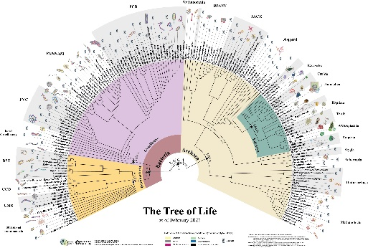
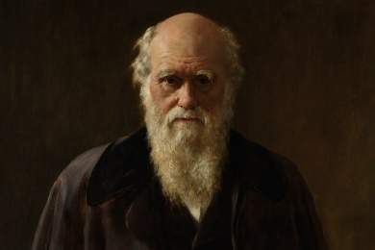
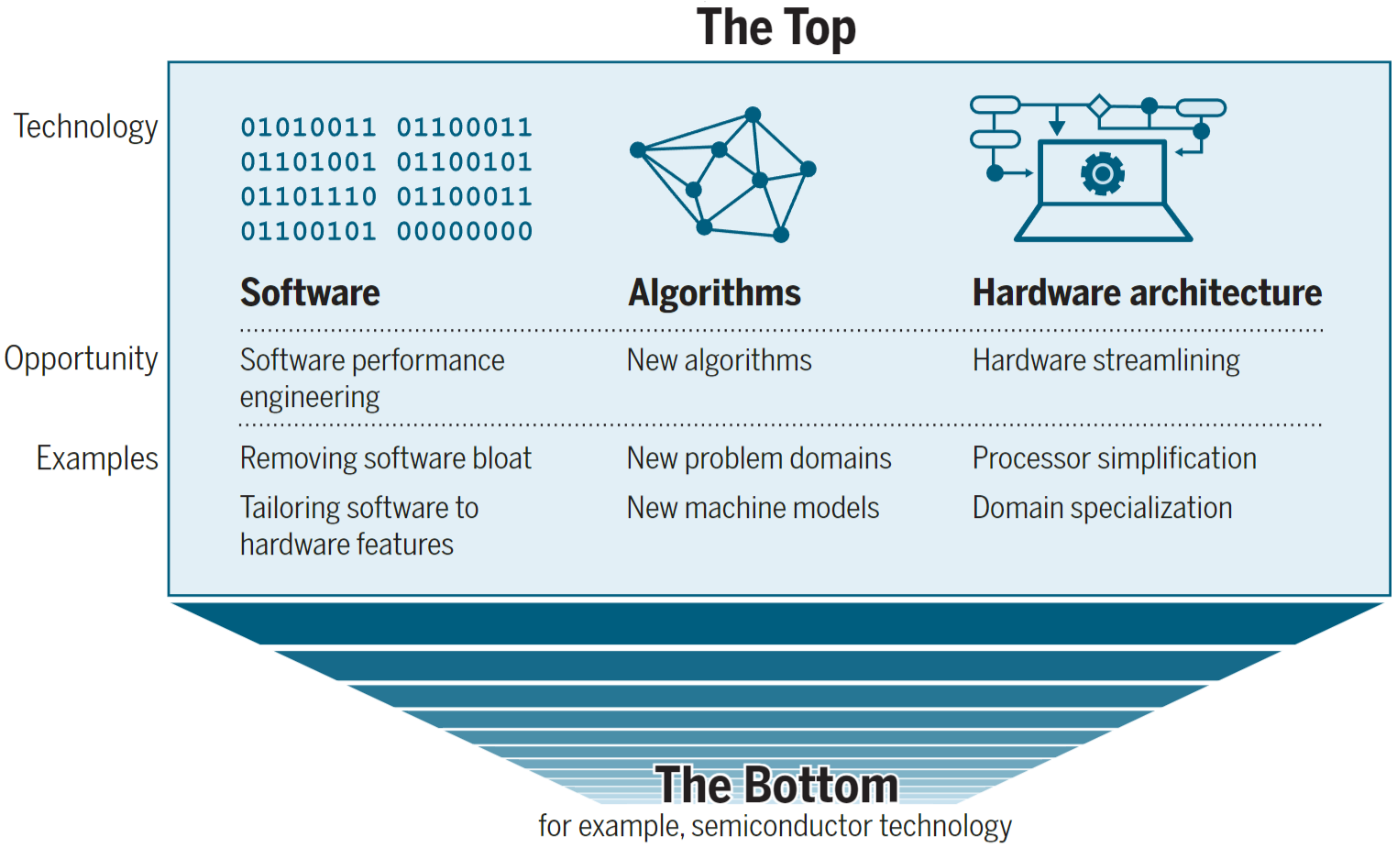
POPulation-Based Randomized Optimization Algorithms (e.g., EA/SI)
In accordance with the increase of computing power (CPU/GPU/TPU/…)
Ending of Moore’s Law [Leiserson et al., 2020, Science; Moore, 1998, PIEEE]
RayES [Moritz et al., 2018, OSDI], TianheDGA [Fan et al., 2020, Science], FunSearch [Romera-Paredes, 2024, Nature], AlpahEvolve [Novikov et al., 2025, arXiv], ……
© Leiserson et al., 2020, Science
https://www.apollo-magazine.com/4-things-to-see-charles-darwin/ Charles Darwin Photo (John Collier): © National Portrait Gallery, London
https://twitter.com/SGribaldo/status/1628431492459241472/photo/1 Tree of Life: © Bacille Diderm Beaud

Slide 18
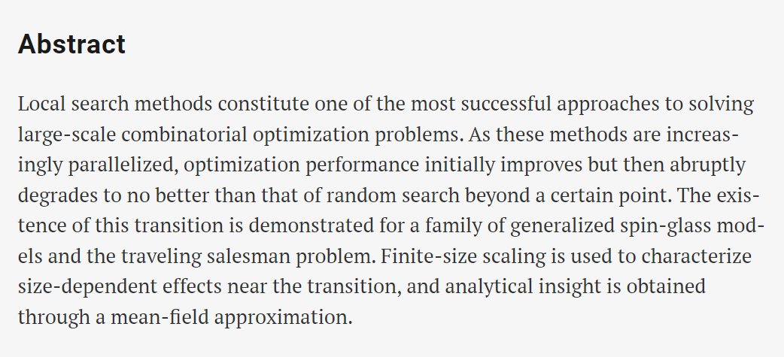
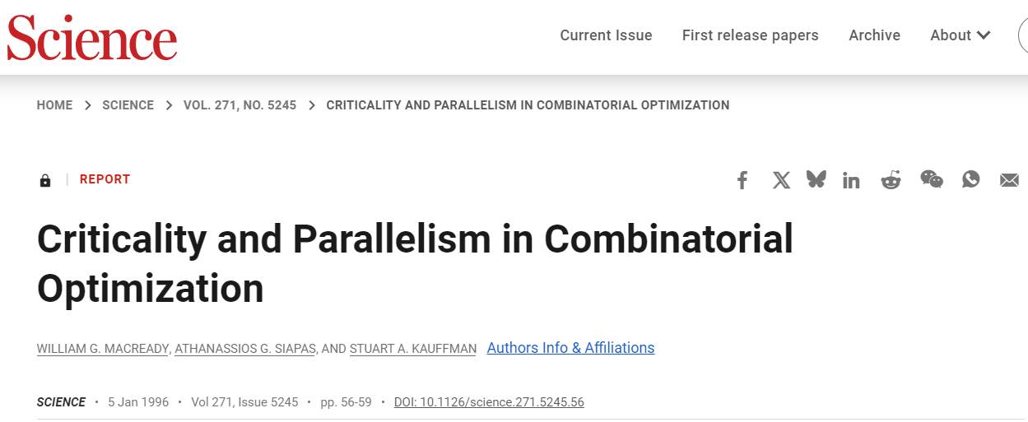
Challenges in Distributed Optimization: Interference from Interactions

Slide 19

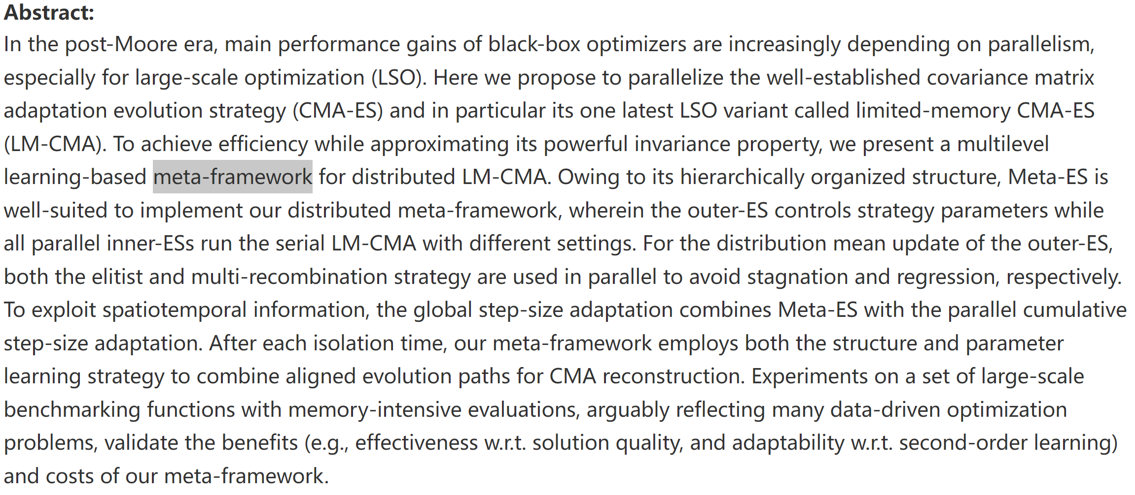
Open Question: Collective (Swarm) Learning

Slide 20
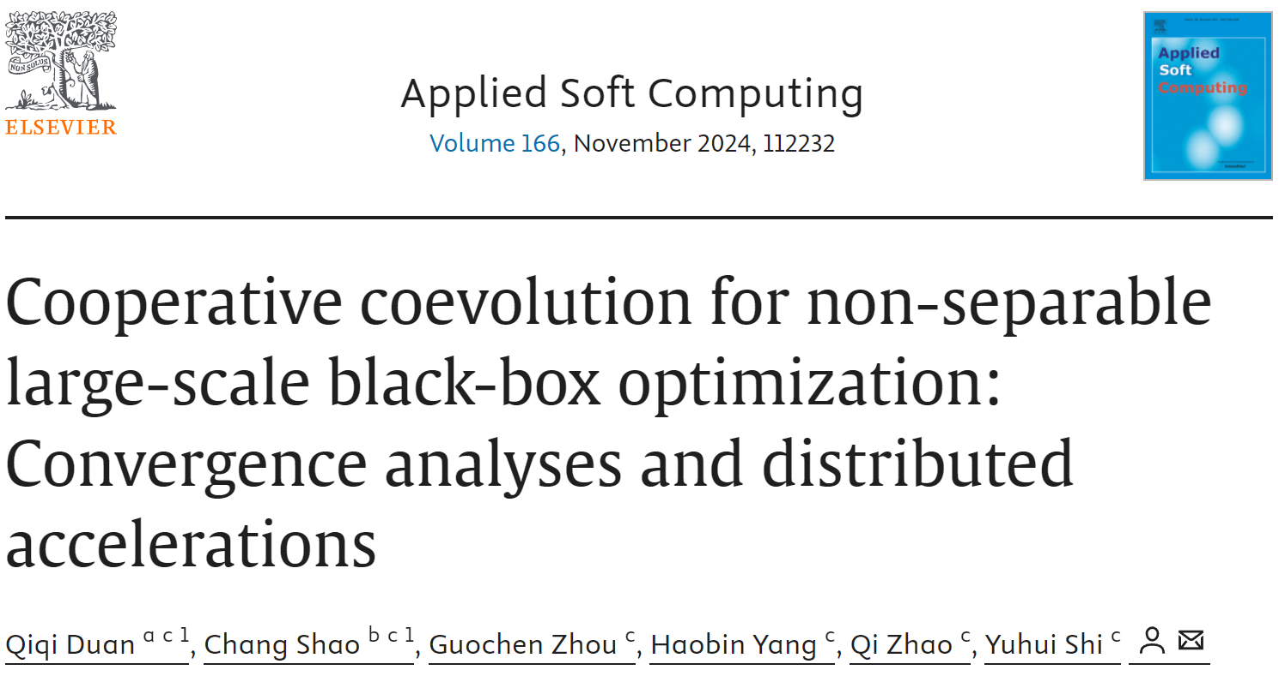
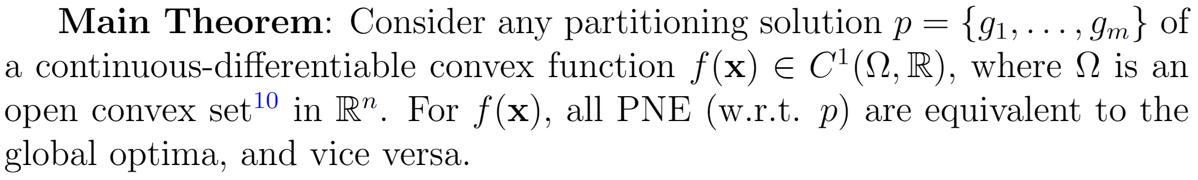
Pure Nash Equilibrium
(PNE)

Slide 21
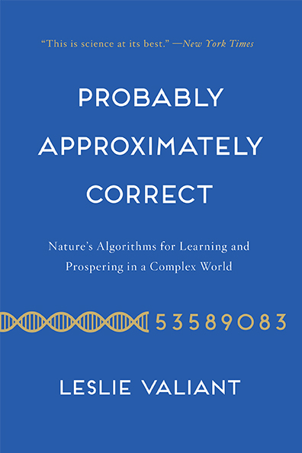
My Own (Not Necessarily Entirely Correct) Opinions on BBO (≠ Absolute Truth)
NOTE: I must admit and respect that other researchers have shown some and even all of the following opinions (in a deeper fashion) before my current representations.
Design principles means generalization, although not always from the explicit(supervision) learning perspective
Invariance (CMA-ES, NES): PCA (unsupervision) / Natural Gradients (optimization)
Unbiasedness: under neutral selection
Meta-Training + Meta-Testing: PES / RL-Based / ……
But NOT as the absolute and even only performance criterion
Generalization has its own boundary on the application range
Problem class to be well solved vs to be not well solved
Under NFLT [Wolpert&Macready, 1997, TEVC]
Under the uniform assumption (of all possible problem spaces)
Bounded generalization
Only with Online Adaptation
https://probablyapproximatelycorrect.com/

Slide 22
What Makes Some (Rather All) Algorithmic Versions of Meta-Heuristics Really “Stand Out (脱颖而出)”?: My Personal View
Excel (Global or Local) Approximation Optimization/Search Abilities (vs Exact)
At least on one NP-Hard problem class (vs Over-Generalization)
Rather than on only one problem instance (or just few)
Solid Design Principles
Rationality (logical and sometimes even philosophical insights)
Generalizability (at least on the target domain > bounded generalizability under NFLT)
Rigorous Theoretical Foundations (e.g. via Mathematical Insights)
Although at the infancy stage, they are often lacked
When entering the mature stage, they are typically emerged
Widely Accessible Open-Source or Commercial Implementations
From the author itself
From the others (further validation and improvement)
Proper Problem-Solving (perhaps the main reason to criticize some MH papers)
Whether or not approximation is practically acceptable
Whether or not approximation is the only solution choice (in reasonable time)
…… (Welcome to supplement)

Slide 23
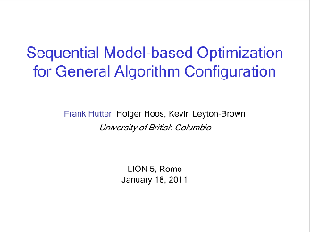
Some of Other Representative BBO Algorithms Not Covered in This PPT
https://aad.informatik.uni-freiburg.de/wp-content/uploads/papers/11-LION5-SMAC-slides.pdf
Sequential Model-Based Optimization (SMAC)
Lindauer, Eggensperger, Feurer, Biedenkapp, Deng, Benjamins, Ruhkopf, Sass and Hutter, 2022. SMAC3: A versatile Bayesian optimization package for hyperparameter optimization. JMLR.
Simultaneous Perturbation Stochastic Approximation (SPSA)
Kleinman, Spall and Naiman, 1999. Simulation-based optimization with stochastic approximation using common random numbers. MS.
Bayesian Optimization (BO)
Turner, Eriksson, McCourt, Kiili, Laaksonen, Xu and Guyon, 2021. Bayesian optimization is superior to random search for machine learning hyperparameter tuning: Analysis of the black-box optimization challenge 2020. NeurIPS.
Wang, Hutter, Zoghi, Matheson and De Feitas, 2016. Bayesian optimization in a billion dimensions via random embeddings. JAIR.
…… (Just to name a few)

Slide 24
Caution for This PPT Content ! (免责声明)
This PPT content reflects my limited and biased knowledge to Black-Box Optimization (BBO), Evolutionary Algorithms (EC), and Swarm Intelligence (SI), etc.
Any extensions, improvements, and corrections to this PPT content are very welcomed!
(Some parts of this PPT material come from my previous Tutorial on IEEE-CEC 2025 and also my own Ph.D. Dissertation. Finally, I acknowledge all references which have inspired this PPT content.)

Slide 25
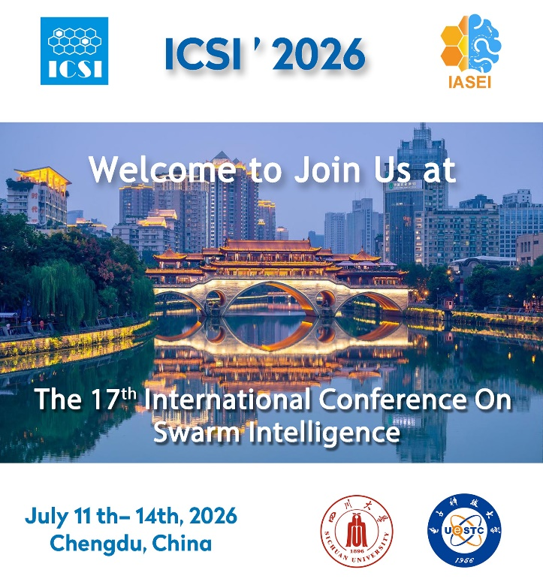
The First Competition on Swarm Learning and Optimization (SLO) for Swarm Intelligence
C-SLO(4SI) will be held on International Conference on Swarm Intelligence (ICSI) in 2026
Organizers:
Qiqi Duan (SUSTech, China)
Lijun Sun (SZTU, China)
Yang Shen (UTS, Australia)
Yuhui Shi (SUSTech, China)

Slide 26
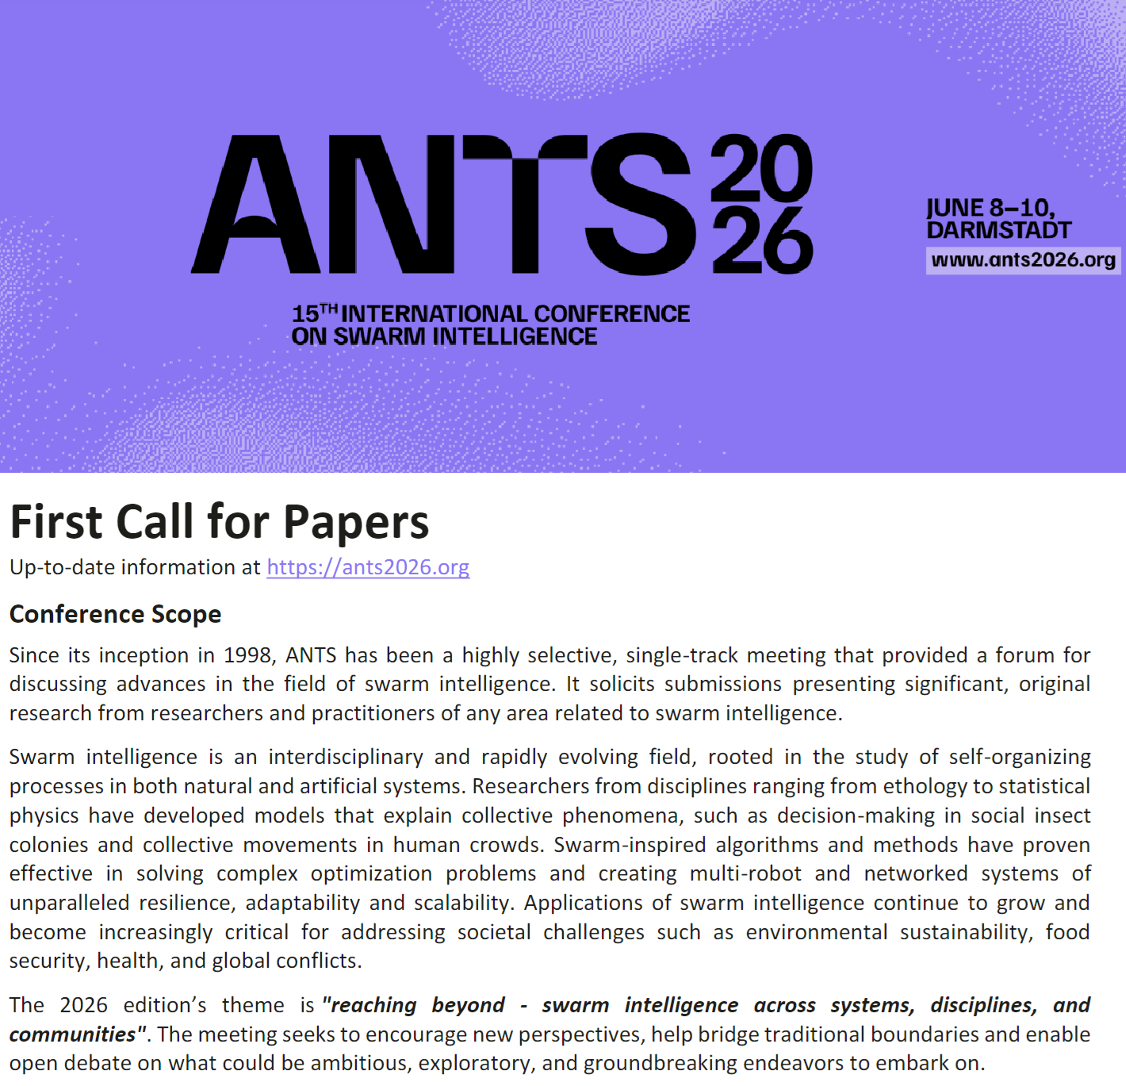
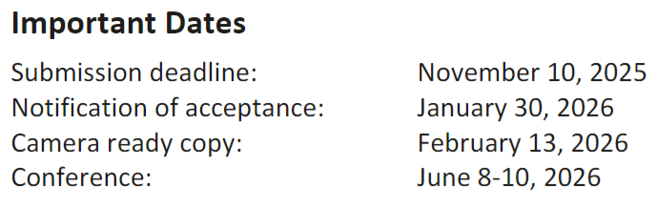
https://ants2026.org/

Slide 27
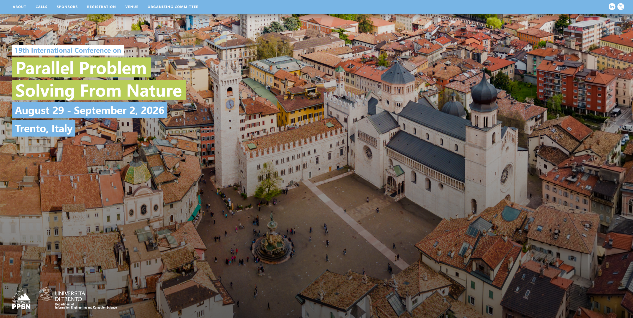
https://ppsn2026.disi.unitn.it/

Slide 28
